Slide 1
Rising 3rd Grade Parents Meeting

Slide 2
Brendan Donahue
Lexington United Soccer Club, DOC Jan 2006 to present
Region 1 Olympic Development Staff July 2015 to present MA ODP Head Coach 2011, 2012
NCAA DI to III Collegiate Coach 1995 to 2005
USSF “A” License 2001 renewed 2013
NSCAA Premier Coaching Diploma 2005
US Youth Soccer Diploma 2009
Coerver Coaching Diploma 2012
bdonahue@lexingtonunited.org 617-529-9865

Slide 3
What you will learn tonight
Fall of 3rd Grade (Increased commitment, changes to the game format, player rotation)
Spring of 3rd Grade (In-town vs. Travel)
Skills Academy
LPDA
Philosophies of the club

Slide 4
K-2nd at Diamond
A, B, C’s
before
Reading and writing

Slide 5
Why No Travel In the Fall?
Corners
Goalies
Referee
Kick-off’s
Goal Kicks
Free Kick’s
Throw-In’s
FANS!

Slide 6
Increased Commitment
Three Weekly Events
Game:
Focus on Performance not results
Pro Practice:
Long term development, building the foundation of the player
Team Practice:
Allow for extended play. Make it directional
The Game
Scheduled on Saturdays
Pro Practice
A weekly professionally guided session at the same location with all other teams within the age group
Team Practice
A volunteer coach led practice at the location of the coaches choosing.

Slide 7
Fall Logistics
Typical Kick-off times:
Saturday
9:00am
10:30am
12:00pm
Pro Practice@ Diamond:
Monday
5:30 to 7:00pm
Demo
5:30 to 5:45pm

Slide 8
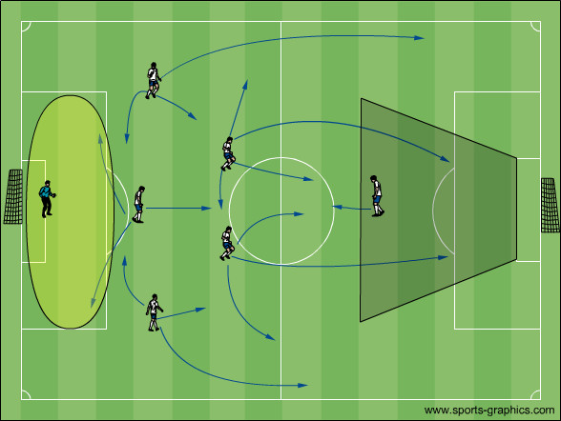
7v7 Positional Demands
K-3-2-1

Slide 9
Player Rotation
Player Rotation Consideration
Reasons to Rotate | Playing at the Back, Dealing with “Talented” Players, Appreciation for Teammates and Roles within a Team
Potential Pitfalls of Player Rotation | Flow of the Game, Learning to Play While Fatigued, Reinforcing Coach’s Feedback
Recommendations | Reduce Number of Substitutions, Rotate at Half, Rotate Game to Game

Slide 10
Spring of 2018 Choice
In-town
Balanced Teams
No Standings
All Games in Lexington
Friendship Requests
1 practice
Saturday Match
Volunteer Coached
Travel
Skill Based
Standings Kept
50% Games in Lexington
FR not considered
2 practices
Saturday Match
Volunteer Coached

Slide 11
Travel Team Formation
Teams Approved
Evaluations & Coaches Feedback
Coaches Meeting
Evaluation Committee Review
Division Directors Team Submission

Slide 12
Skills Academy
The LUSC Skills Academy is:
100% professionally coached
Run gender specific
Training groups tiered by ability
Thursday 4:00 to 5:15pm training
Seasonal sign up (Fall/Winter/Spring)
Who’s Eligible?
3rd through 5th Grade Lexington Players
Is their a team?
Yes, but the team is limited to 3rd and 4th grade players
Limited Friendly Match schedule
4 events in Fall & spring

Slide 13
Skills Academy
Why a Skills Academy?
To provide LUSC children with a yearlong technical development plan under weekly professional supervision for committed and interested LUSC U9-10 players.
LUSC Skills Academy Goals
Improve Players Perception
Decision Making
Execution
The player on the ball has 3 Phases he/she must process and execute each time he/she is in possession.
Perception- What is happening? Your eyes need to observe everything.
Decision Making- What to do? Plan, judge, decide.
Execution- How to do it? (Technical ability is the number one focus of our training program)

Slide 14
LPDA
What is the LPDA?
The LPDA is a player development academy. The entire focus of the coaching staff will be to train players to play the game of soccer at a high level while promoting development and enjoyment.
Who’s Eligible?
All Lexington United Players born in 2007 or earlier (U11-U18)
The LPDA Is a Select Team
Tryouts
Invitation
Why the LPDA?
To provide Elite training under professional supervision for the serious player
Give players an alternative for continued development beyond travel soccer, while remaining true to the LUSC philosophy
Provide Lexington families with a local alternative to Premier Soccer Clubs.
Continue to develop Lexington players within our soccer community

Slide 15
LPDA
The LPDA is a Member of the Northeast Soccer League (NSL) which is an affiliate of US Club Soccer.
A U11-U14 LPDA player will have:
approximately 50 professionally led practices throughout the year
25 professionally coached matches
a season ending tournament

Slide 16
LUSC Philosophy

Slide 17
Lexington United Soccer Club
What are we trying to accomplish here?
To have fun playing
To build friendships
To instill the values of
sportsmanship and fair play
To be active and healthy
To acquire new skills
To learn to deal with both success and failure

Slide 18
Responsibilities
The Coach’s Responsibilities
Be A Role Model
Have Perspective
Prepare Training
Execute Training
Game Day Coaching
Manage Parents
Set Boundaries
The Player’s Responsibilities
Do Your Best
Be a Great Teammate

Slide 19
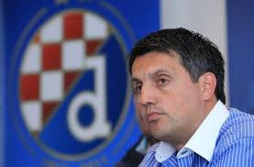
Perspective
“We want our kids to win, we want our kids to want to win, but there are no consequences for not winning.”
Romeo Jozak, Ph.D
Croatian Football Federation
Technical Director

Slide 20
Fixed or Growth Mindset
Carol Dweck
“You must be smart at this”
or
“You must have worked really hard”
Praise Effort not Talent!

Slide 21
Zero Tolerance

Slide 22
Introduction to Coaching Course (Fall)
Why kids play, how kids learn, age appropriate training, economical training, how to build a practice plan, club philosophy, communication with players & communication with parents
Coaching 3rd Grade Soccer (Spring)
The player centered approach, rules of the game, practice planning & what type of coach do you want to be?
Coaching Demonstrations (3rd through 8th grade)
Field demonstration by DOC & ADOC
Topics covered: technical and tactical exercises Q & A with DOC & ADOC
In House Education

Slide 23
Exercise Database
How to Build a Practice Plan User Guide:
http://lexingtonunited.org/list-of-exercises/
Coaching Manuals (U9/10, U11/12, U13/14)
Coaching Videos
http://lexingtonunited.org/category/blog/videos/
Coaching Blogs
http://lexingtonunited.org/category/blog/
In House Education

Slide 24
National Licensing Courses
USSF "F", online U6 - U9 "encouraged"
http://www.ussoccer.com/coaching-education/licenses/national-f
USSF "E", 18 hours U10 - U11 "encouraged"
http://www.ussoccer.com/coaching-education/licenses/national-e
USSF "D", 40 hours U12 - U14 "suggested"
http://www.ussoccer.com/coaching-education/licenses/national-d
LUSC will reimburse upon completion
External Educational
Opportunities

Slide 25
Specialty Topics
Learn from the
Boston Breakers
NSCAA Heading

Slide 26
Thank You for Attending

