Slide 1
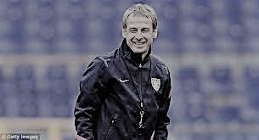
K through 2nd Grade Coaches Meeting
“When you work with young people, you are a difference maker, you’re a game changer. Don’t ever underestimate the power of coaching. You are there to inspire the kids. The payback may not be immediate, but it’ll come later on in life”
“When you work with young people, you are a difference maker, you’re a game changer. Don’t ever underestimate the power of coaching. You are there to inspire the kids. The payback may not be immediate, but it’ll come later on in life”

Slide 2
New Adult Registration Process for Fall 2019
All coaches are required to create a Stack Sports account (detailed instructions provided)
MYSA will run National CORI and Background checks for all coaches
All coaches need to upload their Head’s Up Concussion Certificate (take again if last certification was before August 2018)
Coaches are required to take an online SafeSport Training Course on Abuse Prevention (30 min x 3 sections = 90 minutes)
Ignore the “Safety / Additional Certification” section

Slide 3
Challenges and Work-Arounds
The National Roll-out of this process has not been smooth
MYSA and Stack Sports process has been challenging and delayed
There are significant backlogs in the system
As a result:
The System to print out CORI papers is not working
The system to print out Credential Cards is not working
As a result, we have some work-arounds
Mary will be in contact to check IDs and CORI papers once available
Game Day work-arounds to ensure CORI and Background checks passed

Slide 4
Near-Term Work-Around
The early-season Coach check-in process will be altered
Primary goal: Ensure all Coaches have had background and CORI checks
The Process:
Bring your ID, or a picture of your ID on your phone, to the game
Ensure your name is on the Roster
The Ref will check your ID and make sure you are on the Roster
Issue with BAYS 3-Coach Limit on Rosters
You can bring ANY roster with your name on it
For teams with more than 4 coaches, place coaches who only coach one team on that roster

Slide 5
Thanks for Help with this Process
Keep in mind, these work-arounds are only for the first few weeks
Once the backlog is cleared up, the Credentials can be printed
You still need to complete the Concussion and Abuse Prevention Training!
Concussion training is is good for 2 years
Mary will contact you to check your IDs once the CORI papers can be printed

Slide 6
Program Philosophy
What are we trying to accomplish here?
We want every child:
to be physically active and have fun playing the game of soccer.
to develop a comfort level with the ball at his/her feet (maximum touches)
to be allowed to make decisions with minimal instruction during the game segment (“stimulate rather than instruct”).
to learn basic positional sense (covering space).

Slide 7
The Foundation
A, B, C’s
before
Reading and writing

Slide 8
Foundational Skills
Things kids can learn:
Stopping and Starting
Changing direction at different angles
Using both feet
Pulling the ball back with the sole of the foot
Cutting and turning with the ball

Slide 9
Coach like Steve!
“Guided Discovery”
Pose questions
Lead them to the answer, don’t provide the answer
Can the Lessons of Blue’s Clues Make you a Better Coach?

Slide 10
A Case for Repetition

Slide 11
Sample Activity
The Game: Players dribble throughout the inner grid. The coach can use this free dribble segment to offer several options. When the coach yells:
Turn- players must change direction
Ball Taps- players must perform toe taps on the ball
Foundation- the players must pass the ball back and forth between their legs
Change- step on your ball, move quickly to another ball and continue to dribble
Progress to Spiderman

Slide 12
Coaches To-Do List
Contact team approximately 2 weeks to 10 days prior to the start of the season
Let families know which field to report to
Email Diamond layout to all families
Create name tags for players
Set up snack rotation for the season
Print Team Medical Information to have on site (don’t share with families!)
Steer families to the LUSC website for all cancellations

Slide 13
Diamond Parking

Slide 14
Diamond Layout
Diamond Layout
 |  |  |  |  |  |  |  | Baseball Infield
 |  |  |  |  |  |  | 20 Blue Fields
 |  |  |  |  |  | Spectators |  |  | Spectators
 |  |  |  |  |  | Coaching Area |  |  | Coaching Area
 | 12 Yellow Fields
 |  |  |  |  |  | Spectators |  |  | Spectators
 |  |  |  |  |  | Coaching Area |  |  | Coaching Area
 |  |  |  |  |  | Spectators |  |  | Spectators
 |  |  |  |  |  | Coaching Area |  |  | Coaching Area
 |  |  |  |  |  | Spectators |  |  | Spectators
 |  |  |  |  |  | Coaching Area |  |  | Coaching Area
 |  |  |  |  |  | Spectators |  |  | Spectators
 |  |  |  |  | All Blue Fields for 1st & 2nd Grade Must be Lined with Shooting zones
 |  |  |  |  | All Yellow fields for the U6 program
Note: Please Avoid laying out a field with the Sewer cap on it (yellow field app. 3rd from bottom).

Slide 15
Kindergarten Program Overview
15 minute professional coaching demo of activities
practice plan and feedback provided weekly
30 minutes of Activities (Team A= Field A)
45 minute game segment (2x 20 minute halves)
Dual field approach
Balanced teams (mix of schools)

Slide 16
Dual Field Concept
Each team will have a home field to meet at where they will run their activities each week. Example Team A meets at Field A, Team B meets at Field B etc.
If team A is scheduled to play team B, they will do so on both fields.
The area between the two fields is the designated coaching area with the opposite side of the field being reserved for spectators.
The coaching area allows the coach & players their own space and helps the players separate from their parents which is an important part of the developmental process.

Slide 17
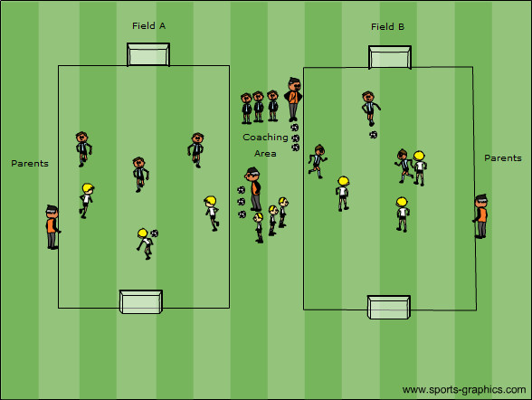
Kindergarten Game Format
3v3 Dual Field

Slide 18
Kindergarten Rules
Kick in’s or dribble in’s (no throw in’s)
Scoring team drops to their own half of field after a goal is scored
No Corner Kick’s- ball over the end-line is always re-entered by the defensive team
3 Goal Margin Rule- team trailing by a 3 goal differential can add a 4th player
No Scores are kept!
No Standings are kept!

Slide 19
1st and 2nd Grade Program Overview
15 minute professional coaching demo of activities
practice plan and feedback provided
45 minutes of activities (Team A= Field A)
45 minute game segment (2x 20 minute halves)
Dual field approach
Balanced teams (mix of schools)

Slide 20
1st and 2nd Grade Game Format

Slide 21
Why 3v3 to 4 Goals?
The 3v3 to 4 goals format is one of the best exercises for players to learn to “read the game” and make decisions without coaches telling them what to do. This is consistent with the LUSC approach that the game is the greatest teacher.
In 3v3 the defense cannot defend both goals equally. This should, in time, teach the players to recognize the 2v1 situation and which goal is the best one to attack. This is why I prefer to play 3v3 over 4v4.

Slide 22
1st and 2nd grade basic rules
All restarts are done with a dribble in or a kick in.
After a goal is scored, ask the scoring team to return to their half of the field.
When the ball goes out over the end-line, the ball is re-entered from the restart line.
Coaches should police (ref) the game to ensure that it is safe, but it is best if they remain 2 to 3 yards from the sideline. No need to run up and down the field with the players.

Slide 23
The Great Pianist
3 L’s
No Laps, No Lines, No Lectures
“A great pianist doesn’t run around the piano or do push ups with the tips of his fingers. To be great, he plays the piano. He plays all his life
and being a great footballer is not about running, push-ups or physical work generally. The best way to be a great footballer is to play football”
Jose Mourinho

Slide 24
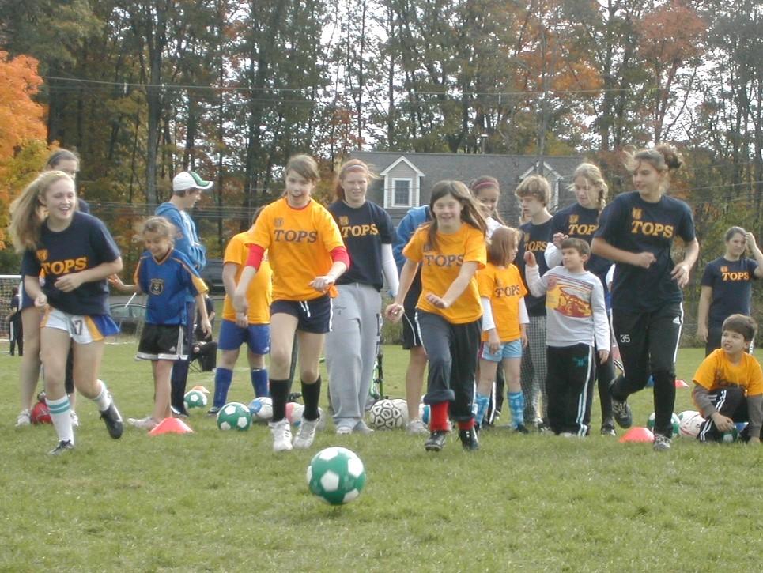
TOPS- The Outreach Program for Soccer

Slide 25
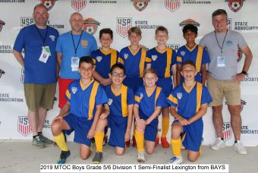
Upcoming Events
An Introduction to Coaching Course
September 7th 1:00 to 4:00pm
Fiske Elementary School library &
Gymnasium

Slide 26
Thank You for Volunteering

