Slide 1
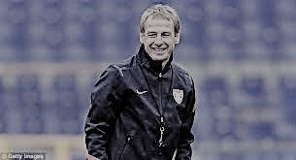
3rd through 8th Grade Coaches Meeting
“When you work with young people, you are a difference maker, you’re a game changer. Don’t ever underestimate the power of coaching. You are there to inspire the kids. The payback may not be immediate, but it’ll come later on in life”
“When you work with young people, you are a difference maker, you’re a game changer. Don’t ever underestimate the power of coaching. You are there to inspire the kids. The payback may not be immediate, but it’ll come later on in life”

Slide 2
New Adult Registration Process for Fall 2019
All coaches are required to create a Stack Sports account (detailed instructions provided)
MYSA will run National CORI and Background checks for all coaches
All coaches need to upload their Head’s Up Concussion Certificate (take again if last certification was before August 2018)
Coaches are required to take an online SafeSport Training Course on Abuse Prevention (30 min x 3 sections = 90 minutes)
Ignore the “Safety / Additional Certification” section

Slide 3
Challenges and Work-Arounds
The National Roll-out of this process has not been smooth
MYSA and Stack Sports process has been challenging and delayed
There are significant backlogs in the system
As a result:
The System to print out CORI papers is not working
The system to print out Credential Cards is not working
As a result, we have some work-arounds
Mary will be in contact to check IDs and CORI papers once available
Game Day work-arounds to ensure CORI and Background checks passed

Slide 4
Near-Term Work-Around
The early-season Coach check-in process will be altered
Primary goal: Ensure all Coaches have had background and CORI checks
The Process:
Bring your ID, or a picture of your ID on your phone, to the game
Ensure your name is on the Roster
The Ref will check your ID and make sure you are on the Roster
Issue with BAYS 3-Coach Limit on Rosters
You can bring ANY roster with your name on it
For teams with more than 4 coaches, place coaches who only coach one team on that roster

Slide 5
Thanks for Help with this Process
Keep in mind, these work-arounds are only for the first few weeks
Once the backlog is cleared up, the Credentials can be printed
You still need to complete the Concussion and Abuse Prevention Training!
Concussion training is is good for 2 years
Mary will contact you to check your IDs once the CORI papers can be printed

Slide 6
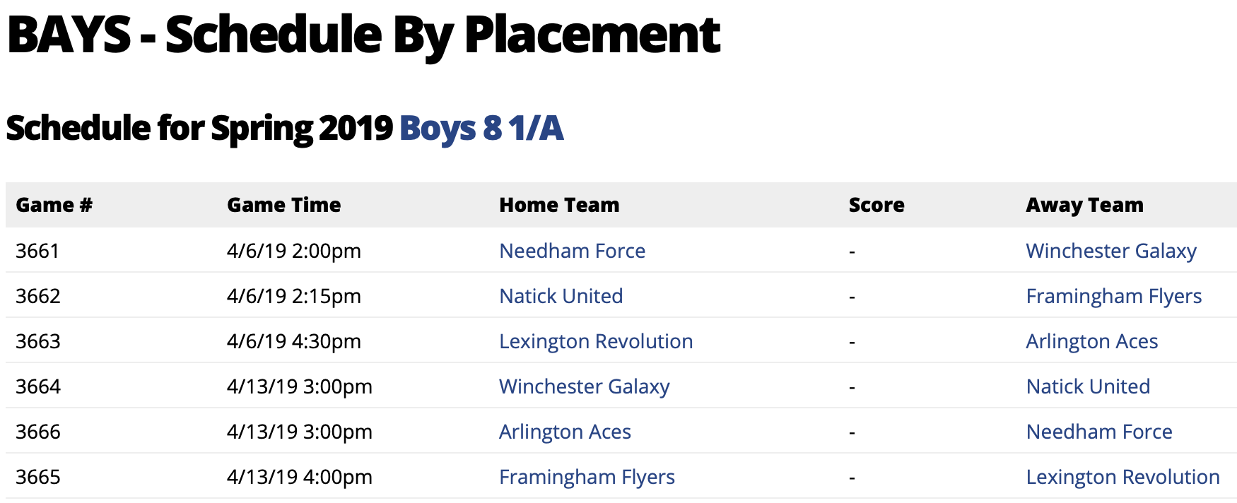
BAYS game schedule
Draft game schedule now live on BAYS website
This is NOT FINAL – need to tweak home games to conform to permit
Game locations and times may change
Some games will move to grass – this will be done equitably
Email will be sent when home game schedule is final

Slide 7
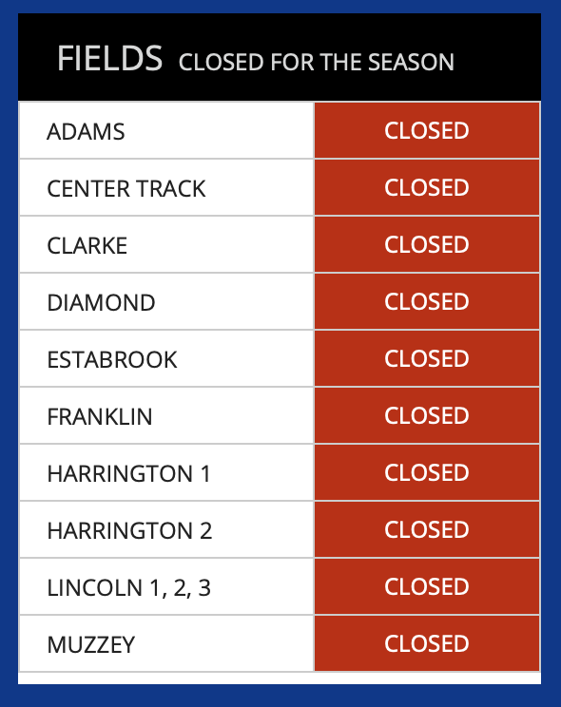
Field status and weather
Check the LUSC homepage!
Weekdays – updated by 2pm
Weekends – updated by 7am after field check
Sometimes, only some fields will be open
Homepage is the main form of communicating field status

Slide 8
Please look after the fields!
Any issues with fields (e.g. safety – email/text/call Tim)
If you find a field squidgy – don’t play
Please encourage litter clear-up

Slide 9
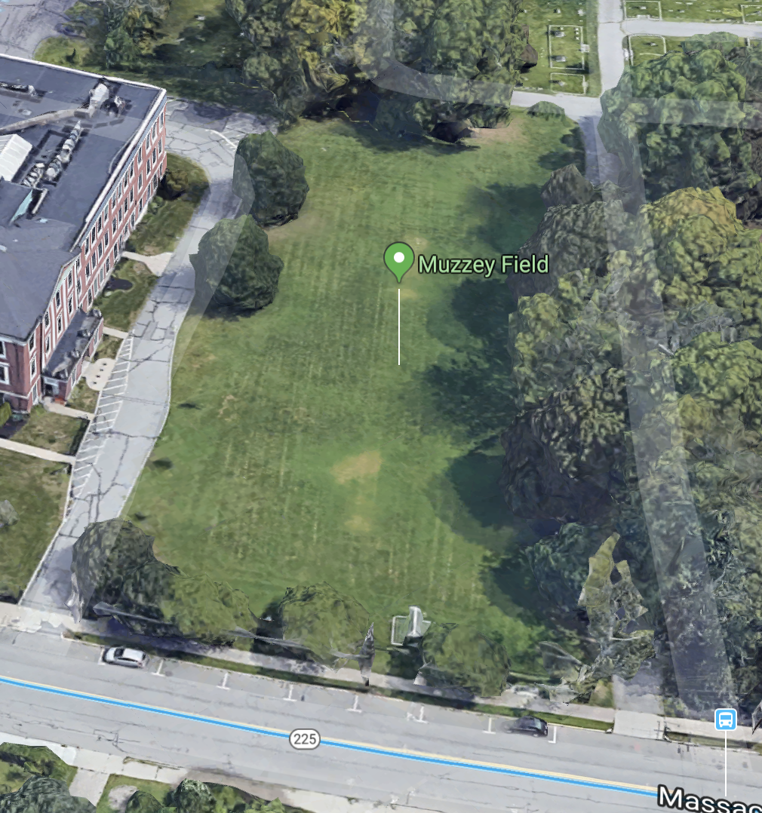
Muzzey Field - conflict avoidance
Muzzey condo driveway is private property
If you are at the Muzzey condos – DON’T USE THE CONDO DRIVEWAY, even for drop-off or pick-up
Please actively communicate this to families
Try to minimize kids entering driveway to collect balls

Slide 10
Lexington United Soccer Club
To develop lifelong soccer players among Lexington youth.
To have fun playing
To build friendships
To instill the values of
sportsmanship and fair play
To be active and healthy
To acquire new soccer skills
To learn to deal with both success and failure
What are we trying to accomplish here?

Slide 11
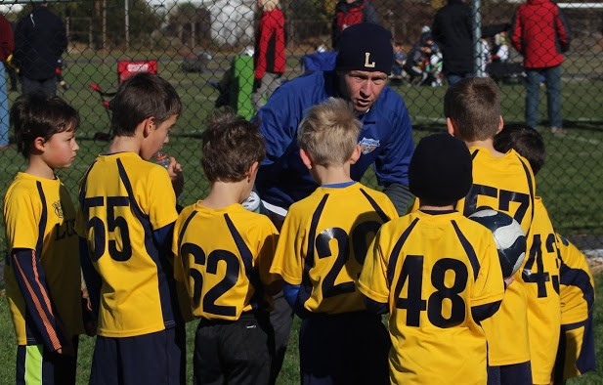
Responsibilities
The Coach’s Responsibilities
Be A Role Model
Have Perspective
Prepare Training
Execute Training
Game Day Coaching
Manage Parents
Set Boundaries
Do your Best!
Be a Great Teammate!

Slide 12
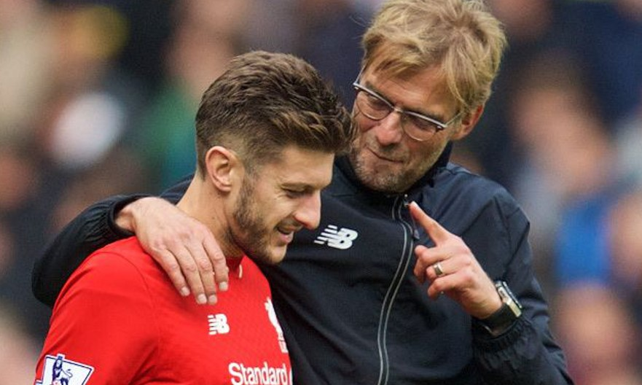
Be a Role Model
The Positive Model
Punctual
Prepared
Perspective
Composed
The Negative Model
Tardy
Unprepared
Lacks Composure

Slide 13
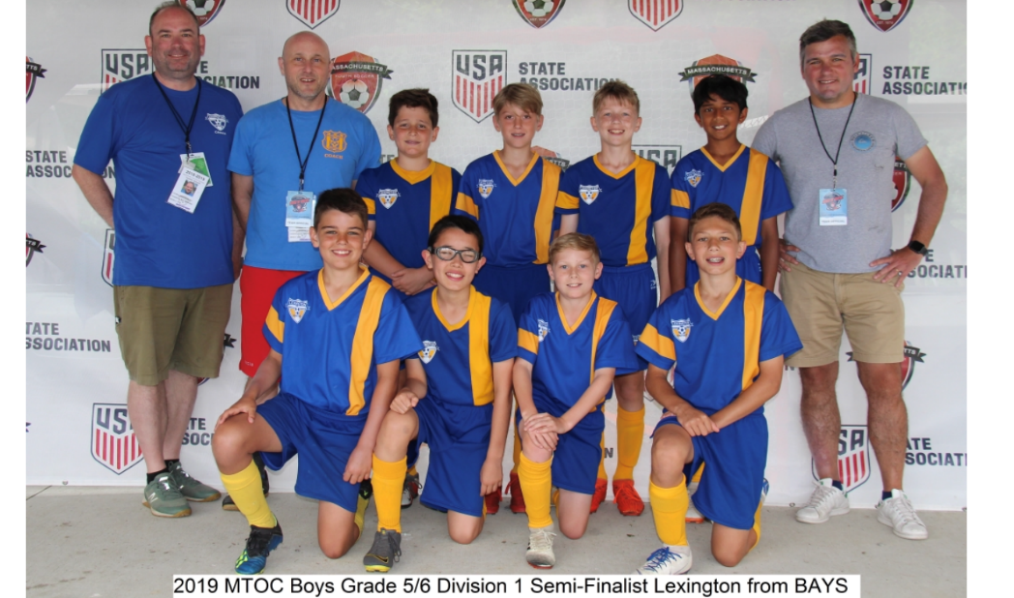
Perspective
“We want our kids to win, we want our kids to want to win, but there are no consequences for not winning.”
Romeo Jozak, Ph.D
Croatian Football Federation
Technical Director

Slide 14
Zero Tolerance
No one, except the players, is to speak to the referee during or after the game.
Exceptions:
Coaches may ask questions before the game,
Coaches may call for substitutions,
Coaches may point out emergencies during the game,
Coaches may respond to the referee if addressed

Slide 15
Level of Violation
L3
Level 2
Level 1
What happens if the referee cites me for a Zero Tolerance violation in his/her game report?
For a level 3 violation, BAYS will notify LUSC, and BAYS will impose an automatic one game (or more) suspension.
For a level 2 violation, BAYS will notify LUSC, and LUSC will impose an automatic one game suspension after the second level 2 violation.
For the lowest level violation, level 1, LUSC will notify the coach that he/she has been cited.
0
1
1

Slide 16
Thank the Ref!
The ONLY Neutral Participant

Slide 17
The Lopsided Score Scenario
Rule to live by:
Don’t embarrass your opponent!
DOC’s preference:
Don’t place false restrictions, but find ways to make the game worthwhile.
Ex.
Drop Off and Counter
Must Change Point of Attack

Slide 18
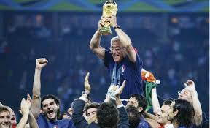
Team Formation Considerations
“BE A TEAM!”
I know it’s a cliché, but, ultimately, the great coach is the one whose formation maximizes the strengths of his players.
-Marcello Lippi

Slide 19
Choosing a System
How do we play when we have the ball?
What spaces do we want to attack?
How many people do we want to commit forward?
Do we attack with the dribble, pass, shot?
How do we play when our opponent is in possession?
What spaces are we willing to concede?
Where do we want to confront our opponent?
How many players do we ask to remain behind the ball?
How compact are we vertically and horizontally?
When we lose possession, how do we react?
Do we send players to pressure the ball immediately?
Do we step up and compact the space?
Do we fall off and play closer to our goal?
Do we react differently depending on the area we lost possession?

Slide 20
Stay Connected!

Slide 21
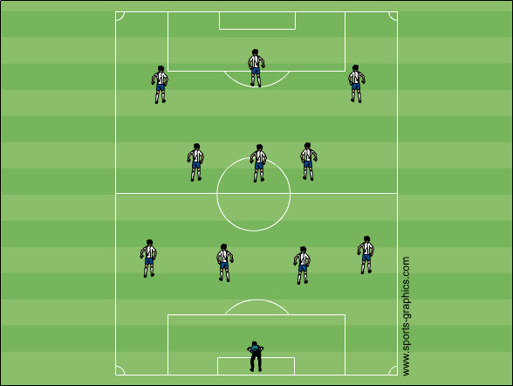
Stay Connected

Slide 22
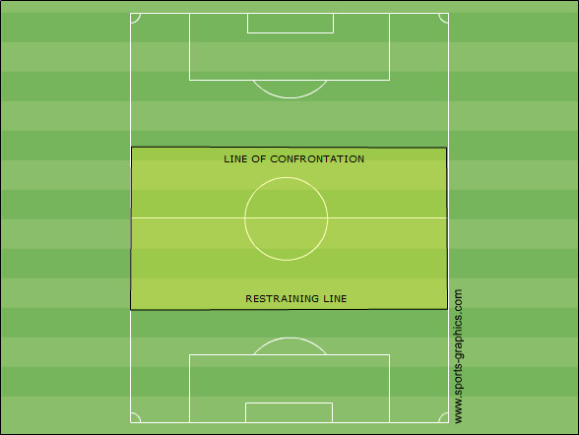
Line of Confrontation
A predetermined spot on the field where the team begins to confront the opposition.
Several factors should be considered when deciding this line.
Speed of your strikers
Speed of the oppositions strikers
Technical ability of opponent
Team’s fitness level
Ability of your goal keeper to control space behind the defense.
Method of attack you plan to use.
35 yards

Slide 23
Restraining Line
The spot on the field where you ask your defenders “to hold a line” and not to drop closer to their own goal.
This line is in direct correlation to the line of confrontation. The restraining line should be no deeper than 35 yards from the line of confrontation.
This will ensure the team remains compact vertically and limits the space the opposition can play through.
35 yards

Slide 24
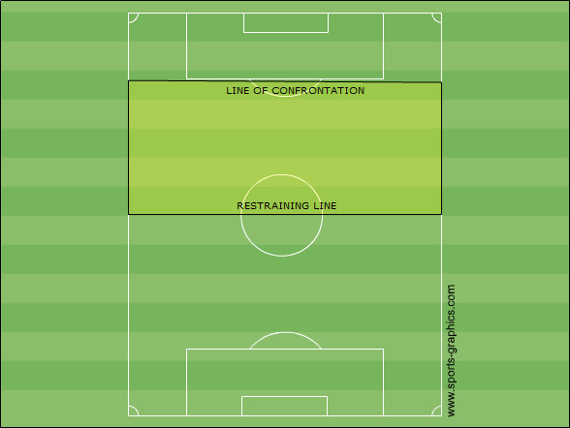
Compactness
High Press
GK

Slide 25
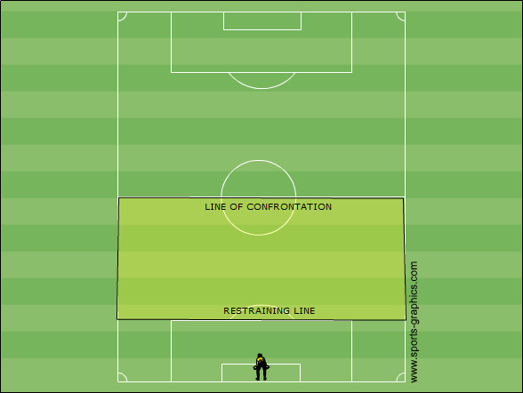
Compactness
Low Pressure

Slide 26
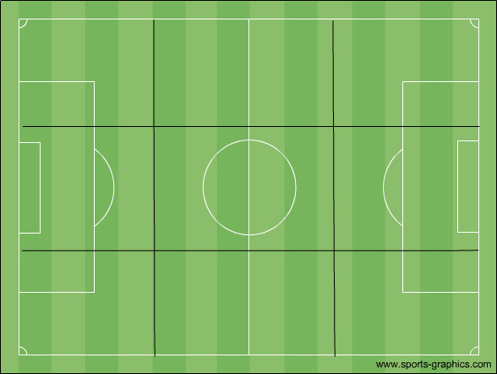
9 Grid Exercise
Defend Four
Grids

Slide 27
7v7
K-3-2-1
K-2-3-1

Slide 28
K-2-3-1

Slide 29
K-2-3-1

Slide 30
K-3-2-1

Slide 31
K-3-2-1

Slide 32
K-3-1-2

Slide 33
K-3-1-2

Slide 34
9v9 Off-sides Introduced
A player can only be offside in the opponent’s half
A player is offside if they are behind the last defender when the ball is played by a teammate and the following occurs; involved in active play, interfere with an opponent or gain an advantage
A player is not offside if they are behind the last defender if the ball is played by opposing team

Slide 35
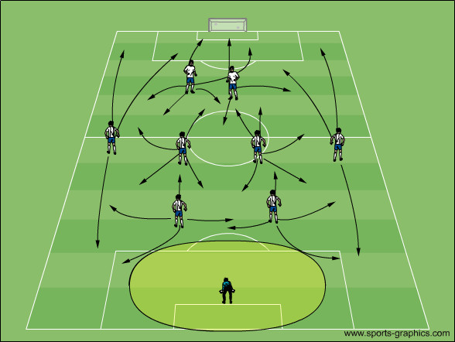
K-2-4-2

Slide 36
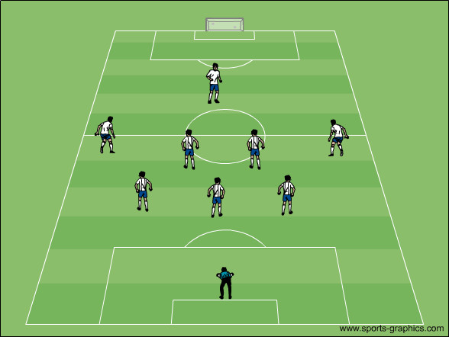
K-3-4-1

Slide 37
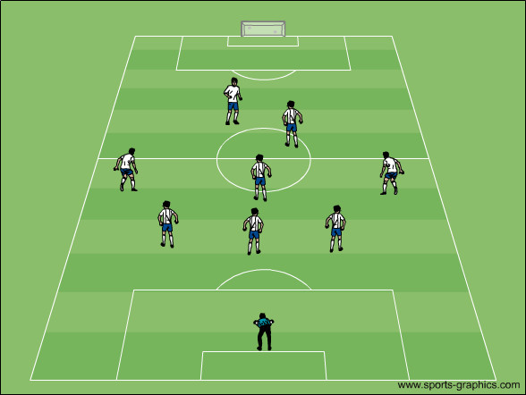
K-3-3-2

Slide 38
11 v11

Slide 39
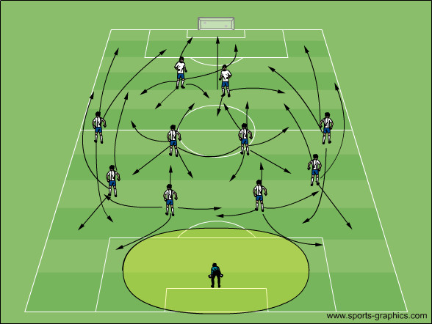
K-4-4-2 (flat)

Slide 40
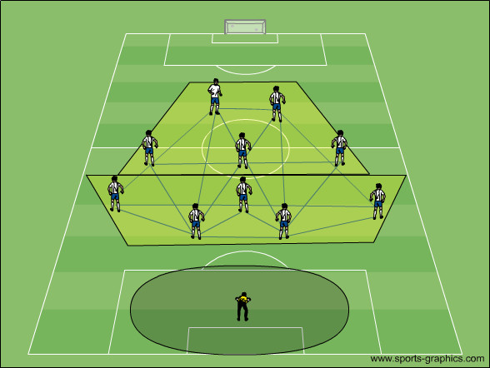
K-4-4-2 (diamond)

Slide 41
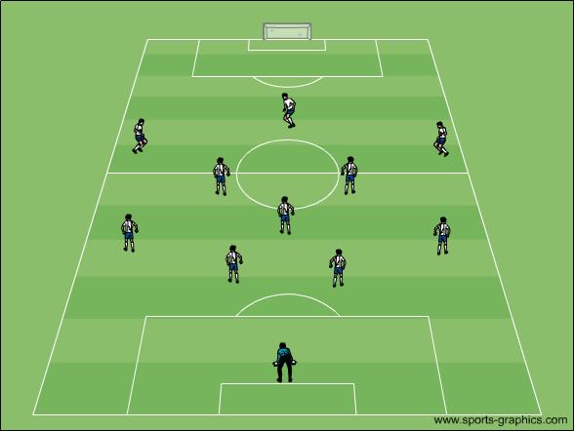
K-4-3-3

Slide 42
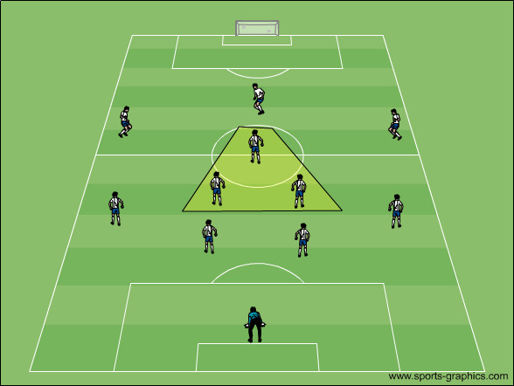
K-4-3-3

Slide 43
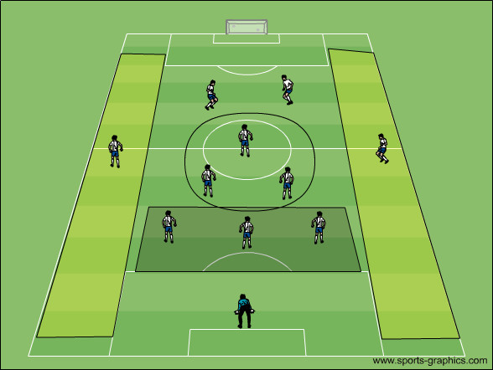
K-3-5-2

Slide 44
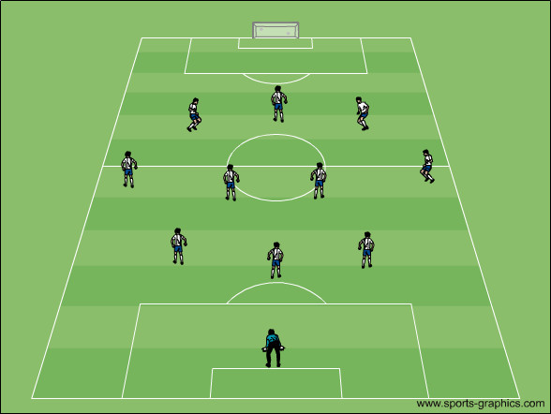
K-3-4-3

Slide 45
When to Change Formation
Oppositions Strengths
Opponents Formation may determine how you can and should change your formation. Ex. two forwards, do you need 4 at the back?
What areas is your opponent attacking? Are they playing through the middle, are they attacking out wide?
Opponent’s style of play. Are they trying to play out of the back or are they hitting long balls in to our defensive 3rd?
Score of Game & Time Remaining
Are we down a goal and chasing the game?
Are we up by a goal and want to close the game?
10 minutes left of the game and our players are tired, change to a more defensive formation and get players behind the ball, stop chasing the ball with high pressure.
Half-Time is a good opportunity to address issues regarding formation, easier to change/explain when team is together than during run of play

Slide 46
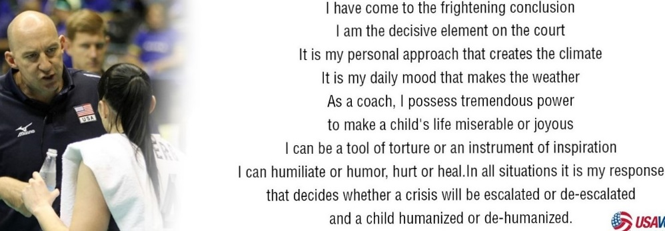

Slide 47
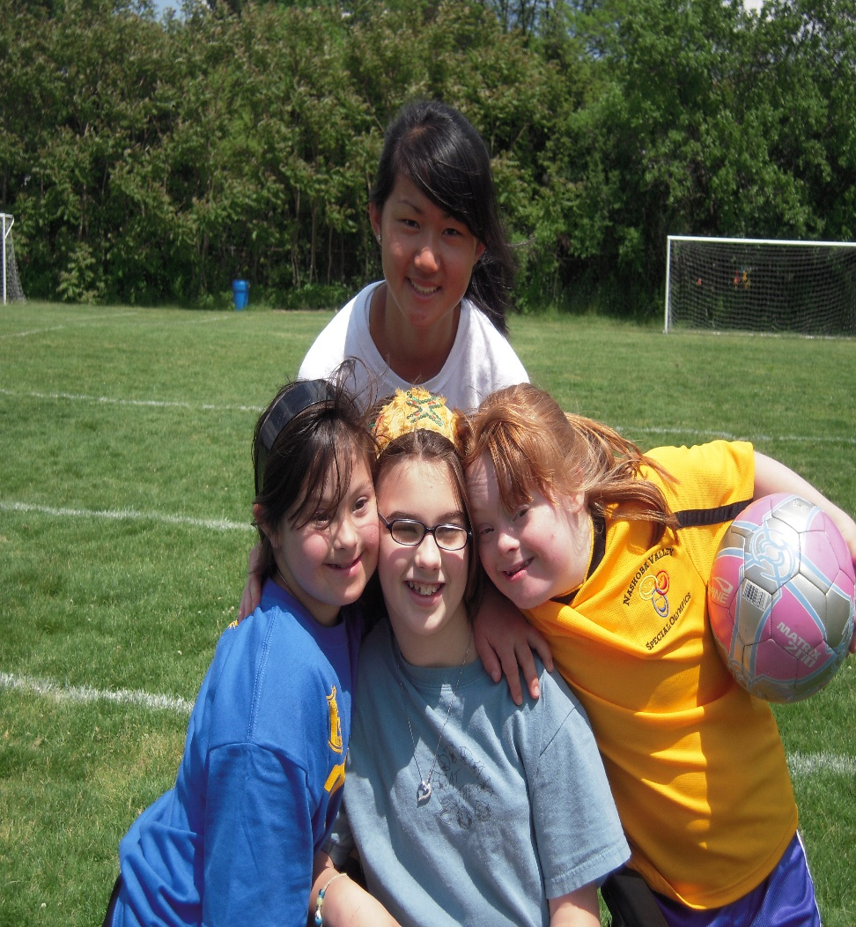
TOPS- The Outreach Program for Soccer

Slide 48
Upcoming Events
Model Coaching Session
When: Saturday August 31st
Where: Lincoln Field #2
9:00am to 10:00am: Effective Practice Exercises w/limited space
10:00am to 11:00am: 5 Favorite Games
11:00am to 11:45am: Coaches Technical Skill Session (Final 15 minutes dedicated to teaching heading)
11:45am to 12:00pm: Q&A
An Introduction to Coaching
When: Saturday 9/7 1:00pm to 4:00pm
Where: Fiske Elementary School library &
gymnasium

Slide 49
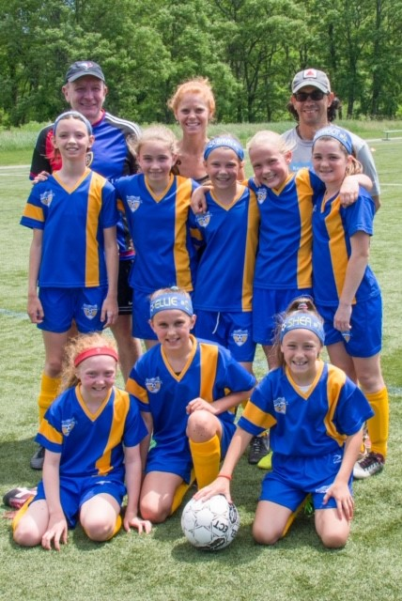
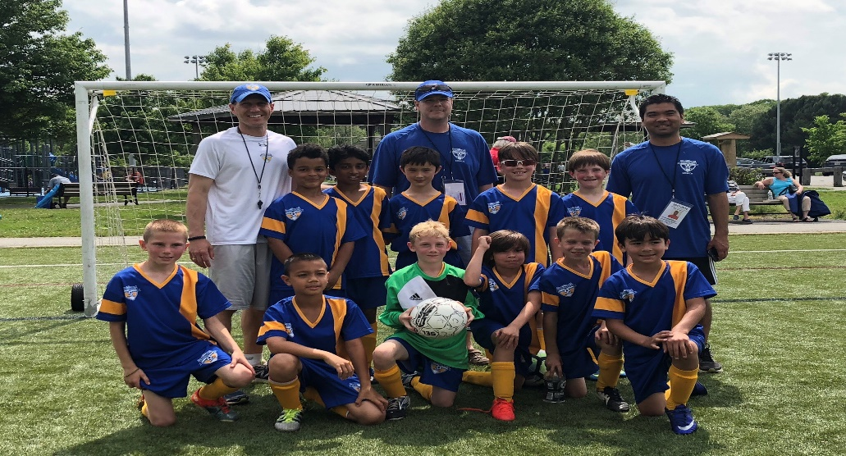
Enjoy the Journey!
Welcome the First Mistake!

Slide 50
Thank You for Volunteering

